Slide 1
Computer Vision applied to Dengue’s Larvae Death Rate Calculation
Preliminary Results
SOUZA, K. P.; QUEIROZ, J. H. F. S; PISTORI, H.

Slide 2
Introduction
Main task
Development of more effective larvicides to combat Dengue’s transmitter mosquito.
Requirements
Many experiments with different substances
Lab tests, such as larvae death rate (human task)
Problem
Errors due to human limitations during analysis can reduce results quality (e.g. exhaustion, subjectivity, and inaccuracy)
Proposal
LARVIC: Computer vision application for larvae counting

Slide 3
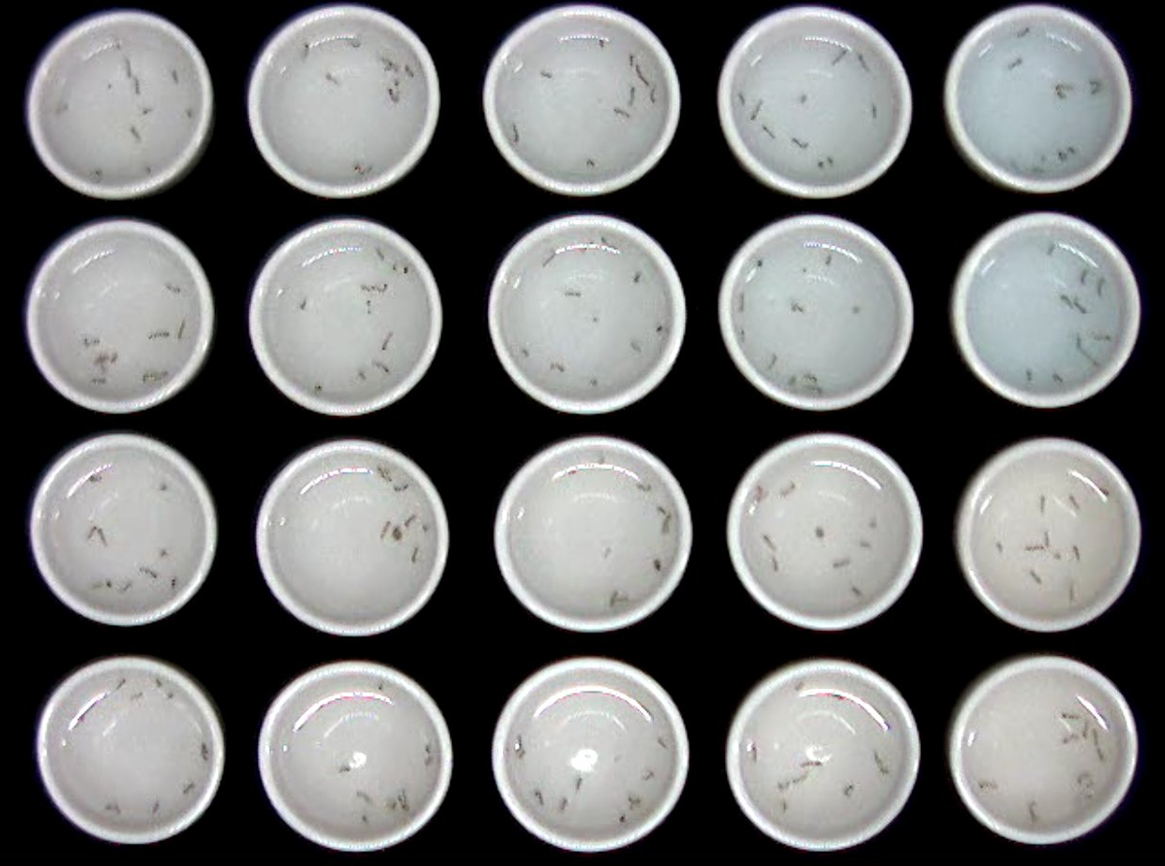
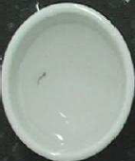
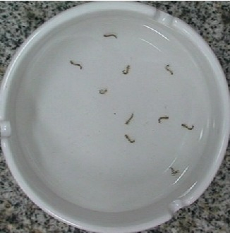
Methodology
Fixed camera positioned above recipients with larvae
Image sequences are captured and then processed by a computer vision application to classify larvae into two classes: death or alive.

Slide 4
Work features
Single recipient with only one larva
Techniques: HMM, HMM+ML, ML
One token extracted from each frame
Segmentation: background subtraction, machine learning and semi-automatic
Feature extraction: Hu Moments, K-Curvature Histogram, Shape Features (aspect ratio, form factor, roundness, compactness)
Classification: C4.5, KNN, SVM and MLP (weka)
Stretched
Curved

Slide 5
Experiments
Three image sequences of 1300 frames
Dead larva: 2 sequences
Live larva: 1 sequence
Small shots extracted from sequences (~100 frames each)
Dead larva: 24 shots
Live larva: 10 shot
Training set: 2/3 of shots
Testing set: 1/3 of shots
Analysis metrics: Hit rate and AUC

Slide 6
Experiments and results

Slide 7
Experiments and results
Stopping Criteria
Three different strategies to define the number of iterations for HMM training
1) No increase happens, 2) difference is under a threshold and 3) fixed number of iterations.
Random
Strategy 1: No increase happens: 12% higher using random probabilities
Strategies 2 and 3: no changes
Pré-computed manually
Strategy 1: No changes
Strategies 2 and 3: increases from 3 to 12%
Pré-computed automatically
No gain

Slide 8
Experiments and results
HMM+ML
No gain using the best initialization and stopping criteria found in previous experiments
Only ML
Algorithms: IBK, J48, SVM, and MLP
Fixed number of features
Three sets of features: token counting (2 features), changes between tokens (4 features) and general token changes counting (1 feature).
Best results (Maximum AUC of 0.97)

Slide 9
Conclusions
Pre-computed initial probabilities obtained better results than random probabilities.
Manually (onerous) and automatically pre-computed initial probabilities obtained close results.
Considering computational cost, low fixed number of iterations was appropriate for training in this application.
No improving detected with combined classifiers.
HMM performance was lower than some “vector features” classifiers performances.

Slide 10
Future work
Analysis of larger sets of different samples of live and dead larvae
Use of other algorithms for training HMM’s
Analysis of classifiers based on machine learning algorithms with different patterns

Slide 11
Agradecimentos
UCDB
FUNDECT
CNPQ
CAPES
CPP
MAIS INFORMAÇÕES: www.gpec.ucdb.br/inovisao

