Slide 1
Grammars and Learning for Scene Classification: A Survey
Hemerson Pistori, Andrew Calway and Peter Flach

Slide 2
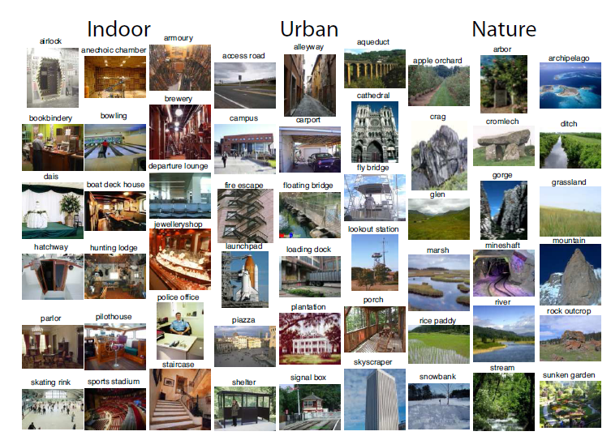
SUN Database: Large-scale Scene Recognition from Abbey to Zoo Jianxiong Xiao – MIT and Brown University
First large scale image database for scene recognition
130,519 images and 899 categories
Evaluation of state-of-the-art algorithms and human performance
Introduces the scene detection problem (in multiple scenes images)

Slide 3
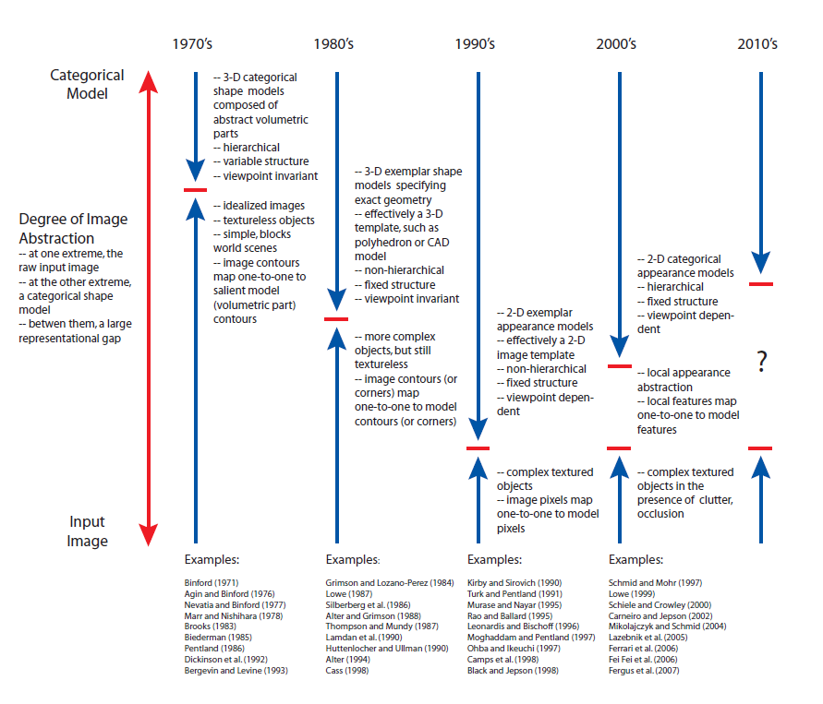
The Evolution of Object Categorization and the Challenge of Image Abstraction Sven Dickinson – University of Toronto
History of object categorization and degree of image abstraction
Need for new image abstraction mechanisms
Large survey (275 refs)

Slide 4
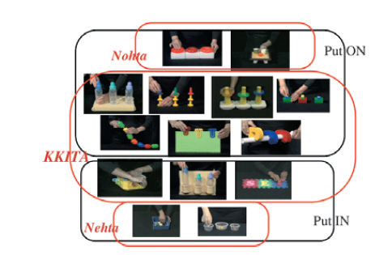
Relative Contribution of Perception/Cognition and Language on Spatial Categorization Soonja Choi and Kate Hattrup – San Diego State University
Both universal cognition/perception and language-specific semantics guide spatial categorization
Use of Universal or Language specific resources depends on type and context
Experiments with Koreans and English speakers

Slide 5
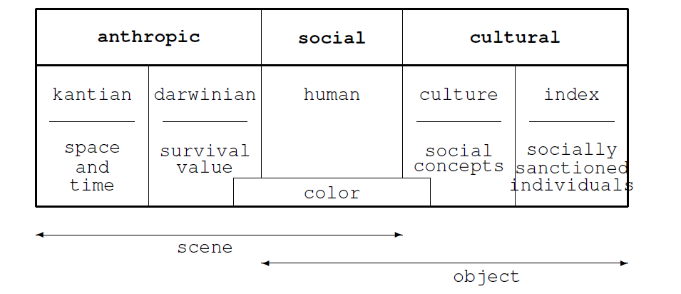
On the Definition of Categories for Image Classification Evaluation Simone Santini
Semiological level of signification (portion of meaning that does not depend on context)
Coherent set of categories for image analysis evaluation
Semantic axis:
Anthropic: openness, expansion, transience, concealment, navigability, fractality;
Social: presence of people, color;
Cultural: “there are so many social forces that influence the connotations of a picture that isolating a semiological level might be impossible”

Slide 6
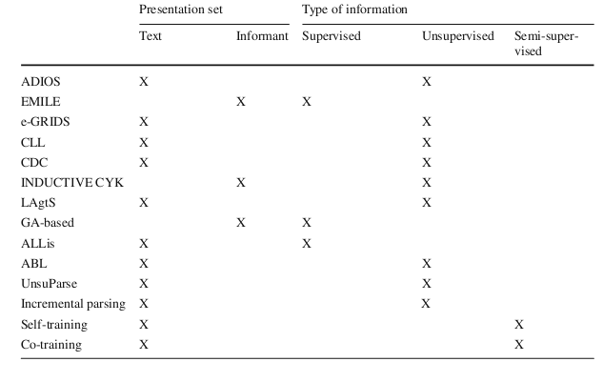
A Survey of Grammatical Inference Methods for Natural Language Learning Arianna D’Ulizia et alii – CNR, Italy
Context Free Grammars Only
Literature review only

Slide 7
Object Bank: A High-Level Image Representation for Scene Classification & Semantic Feature Sparsification Li-Jia Li et alii – Stanford and CMU
Visual knowledge readily available on the Internet (LabelMe and ImageNet)
Features: Responses from object sensing filters built on a generic collection of labeled objects
Object detector of Felzenszwalb et al.
200 most frequenty objects in Labelme, Imagenet, ESP and Flickr

Slide 8
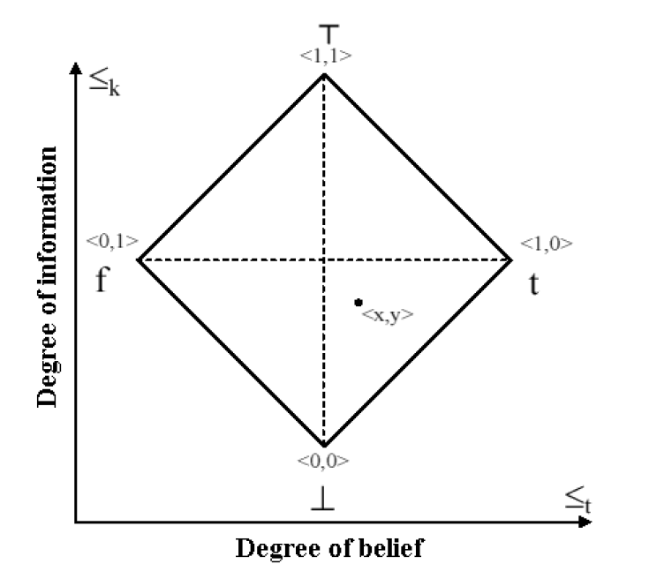
Predicate Logic based Image Grammars for Complex Pattern Recognition Vinay Shet et alii – Siemens and University of Maryland
Bilattice based Logical Reasoning Framework
Pedestrians and Surface to Air Missile Site detection
Contextual Cues, Scene Geometry and Object Pattern Constraints as Rules in a Logic Programming Language
Pattern Grammar as logical rules over predefined atoms
Rules are manually encoded and designed to facilitate scalability
Parts Detectors (E.g.: Human Parts) get the facts or evidences
Rule weight optimization using KB-NN

Slide 9
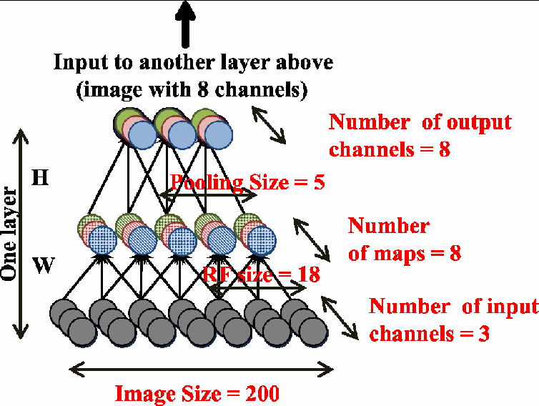
Building high-level features using large scale unsupervised learning Quoc V. Le et alii – Stanford
10 million 200x200 image frames from youtube videos
17% - percentage of faces in dataset (frames containing faces or area covered by faces ?)
1000 machine during one week
Grandmother cell
Deep autoencoder with sparsity
Local receptive fields (RF)
Learning: Topographic ICA
6 Sublayers (3 layers)
Experiment: selection of best
neuron and thresholds uses
classif. Accuracy (supervised)
RGB

Slide 10
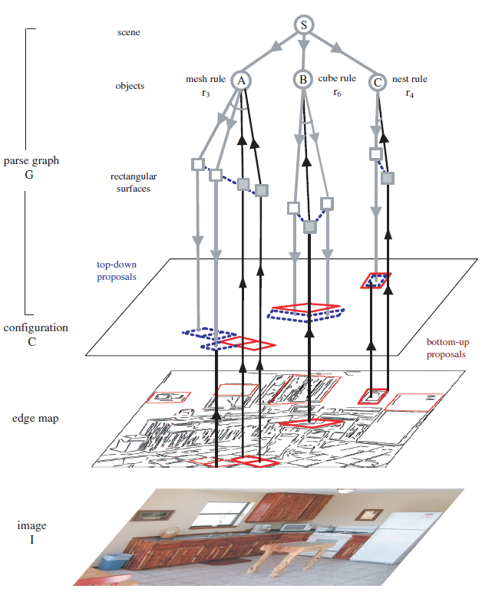
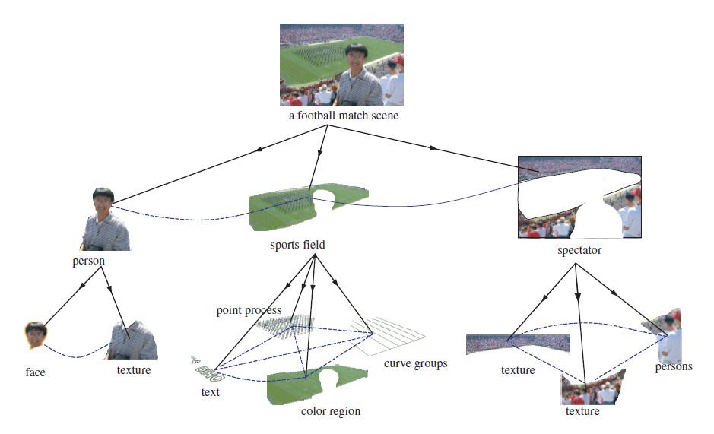
A Stochastic Grammar of Images Song-Chun Zhu et alii - University of California
Visual dictionaries and and-or graph composition to fill semantic gap (symbols and raw signals)
Stochastic grammars
Combine bottom-up and top-down procedures
Graphical models (MRF)
Semi-automatic parsed
images: http://www.imageparsing.com/

Slide 11
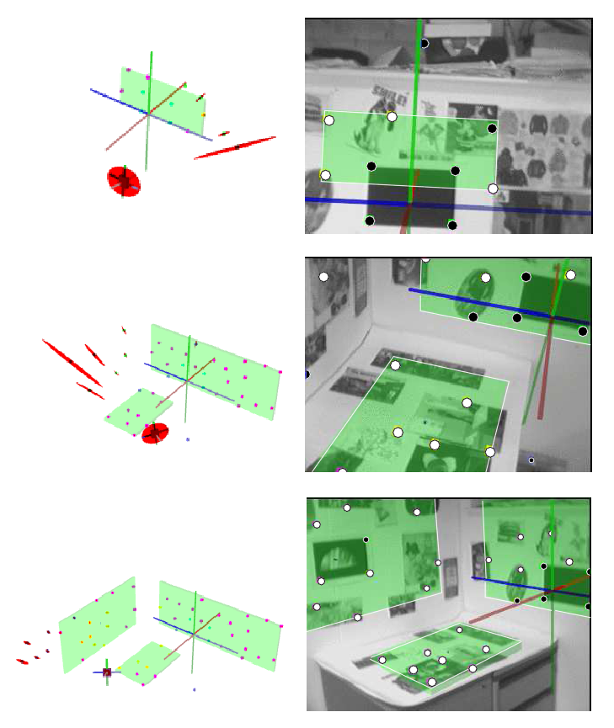
Discovering Higher Level Structure in Visual SLAM Andrew P. Gee et alii – University of Bristol
Discovery of planes and lines
Predictive filtering (EKF)
Dynamically changes in state size
Combines points (or edglets) with planes
and lines

Slide 12
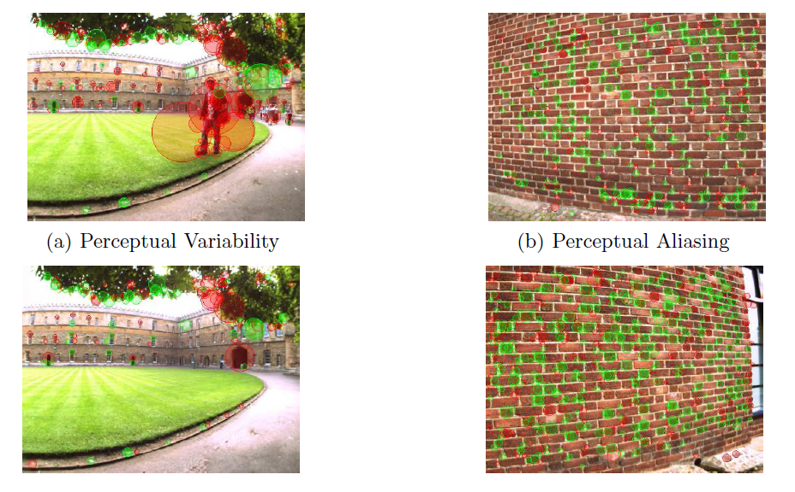
FAB-MAP: Appearance-Based Place Recognition and Mapping using a Learned Visual Vocabulary Model Mark Cummins and Paul Newman – University of Oxford
Uses bag-of-words (BoW)
Tree-Structured Bayesian Network and Recursive Bayesian Filtering in place of Term Frequency – Inverse Document Frequency (TF-IDF)
Chow Liu algorithm
Tackles perceptual Aliasing and Variability using a Probabilistic Model on top of BoW
Green: Common words
Red: Others
Same Place
Different Place

Slide 13
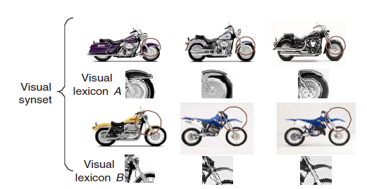
Visual Synset: Towards a Higher-level Visual Representation Yan-Tao Zheng et alii – National University of Singapore and Google Inc. USA
Extends bag-of-words
Polysemy: delta visual phrases (co-occurrance + spatial inf.) - Frequent item-set mining (FIM)
Synonymy: visual synsets (synonymy sets) – supervised learning – labeled image classes (“semantic”) – Information Bootleneck Principle
Visual lexicon = delta visual phrases and visual words

Slide 14
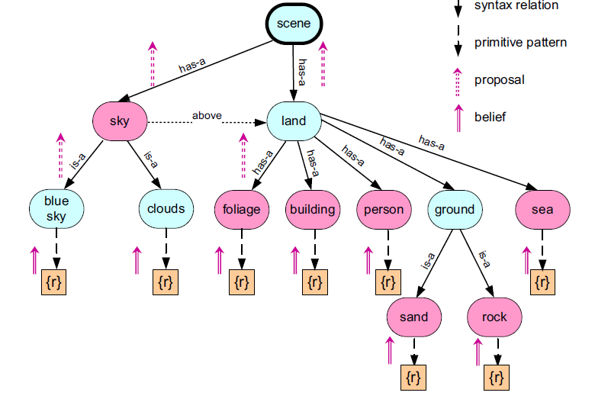
Syntactic Image Parsing using Ontology and Semantic Description Ifeoma Nwogu et alii – University of Rochester and University of Buffalo
Formal ontology for natural outdoor scenes (Mereological Relationships and First Order Logic)
Image grammar based in F. S. Ku proposal (1970)
Does not present the connexion between the Grammar formalism and First Order Logic or between the Grammar and the Parsing Strategy
Low-level: MRF Graph of Superpixels (over segmentation)

Slide 15
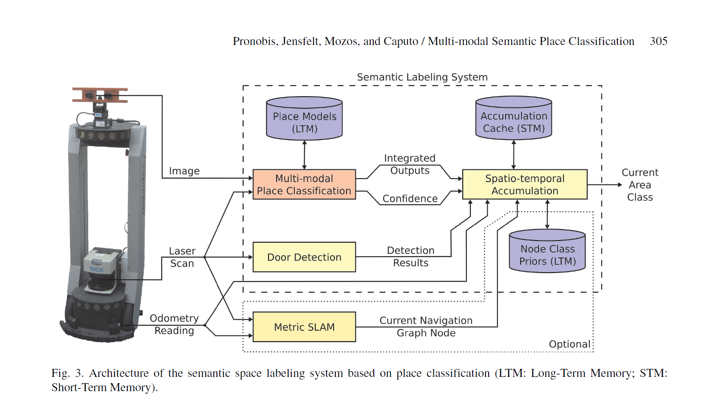
Multi-modal Semantic Place Classification A. Pronobis et alii – Royal Inst. of Technology, Sweden
Combination of clues: local (SIFT), global (CRFH) visual features and laser scan
SVM in two levels (each clue, resulting scores)
Odometry information to help “Semantic Labeling” (give a name to the place where the robot is ?)

Slide 16
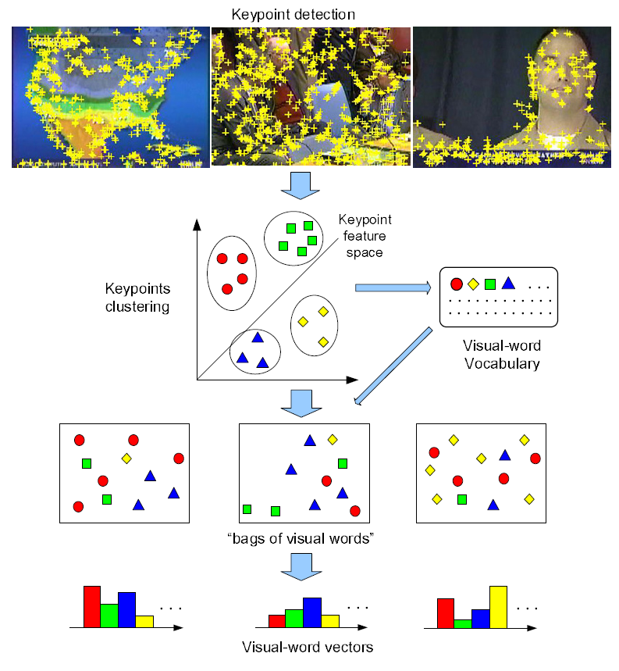
Evaluating Bag-of-Visual-Words Representations in Scene Classification Jun Yang et alii – CMU and City University of Hong Kong
Evaluate “text classification analogies” to produce different Bag-of-Visual Words (term weighting and normalization, stop word removal, feature selection, ...) and other BoVW “parameters “(vector size, use of spacial information, ...)
Datasets: TRECVID 2005 (20 most frequent concepts: outdoor, indoor, objects and people activities) and PASCAL 2005 (only 4 categories: motorcycles, bicycles, people and cars)

Slide 17
How could we use, improve and merge these works
Xiao (SUN Dataset)
Benchmark to evaluate our proposal
Dickson (Evolution of object categorization)
Support our quest for new structural representation and inference mechanism
Choi (Spatial perception and language)
We must take into account during our research
Santini (Definition of categories)
We must take into account when building our grammar
D`Ulizia (Survey on grammar inference)
Maybe we can use/adapt one of these method for visual grammar learning
Li (Object Bank)
Maybe we can improve this method introducing higher level structure using grammars
Shet (Predicate Logic based Visual Grammar)
Can be used as our representation mechanism
Le (Large scale unsupervised learning)
Maybe we can also benefit from paralelism and grid computing
Zhu (Stochatisc grammar of images)
Maybe we can use some of the general rules they have proposed

Slide 18
How could we use, improve and merge these works
Gee (Higher level structure for SLAM)
Maybe we can get even higher level structures and extend the states used by the Kalman Filter
Newman (FAB-MAP)
Not sure … compare against ?
Zheng (Visual Synset)
Can be used as grammar atoms … facts …
Nwogu (Ontology)
Maybe the superpixel concept is usuful
Pronobis (Multi-model)
We can also use multi-model …
Yang (Evaluation bag-of-words)
Not sure if we must use bag-of-words at the low level feature level. Maybe we can compare the alternatives

